Slide 1
HEMI 2
Hyper-Envelope Modeling Interface 2
Uses Bezier curves to minimize over-fitting
Allows automatic fitting with manual adjustment
Provides interactive mode for developing models and batch model (“Monte Carlo”) for validation and uncertainty analysis.
Notes:
Quick intro to Tamarix

Slide 2
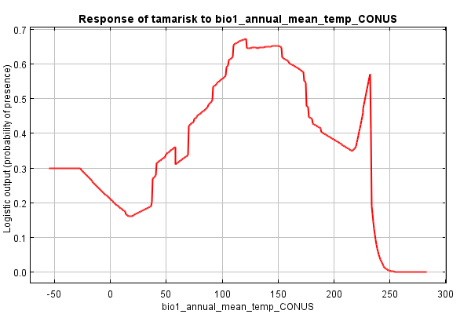
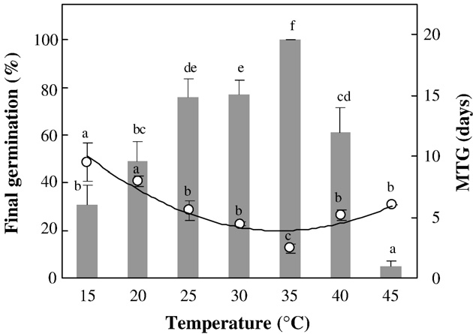
Over-fitting The Data?
Maxent model for Tamarix in the US: response to temperature when modeled with temperature and precipitation
What should the
model look like?
Maraghni, M., M. Gorai, and M. Neffati. 2010. Seed germination at different temperatures and water stress levels, and seedling emergence from different depths of Ziziphus lotus. South African Journal of Botany 76:453-459.
Notes:
Ran tamarix model with Maxent
Regularization parameter to improve over fitting
Challenges with current approaches are predicting outside the same area, models are not well behaved outside the sampled environmental space

Slide 3
From the Theory of
Biogeography
+
0
-
Salinity
Environmental Space
Population Growth
Niche
+
0
-
Salinity
Temperature
Temperature
Brown, J.H., Lomolino, M.V. 1998, Biogeography: Second Edition. Sinauer Associates, Sinauer Massachusetts
Notes:
Temperature is based on enzyme reactions

Slide 4
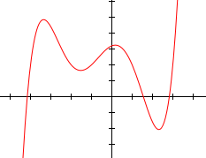
Problems with Polynomials
f(x) = a₀ + a₁x + a₂x² + ... + a_{n}x^{n} , where a_{n} ≠ 0 and n ≥ 2
Lack flexibility
Not well behaved at boundaries
Wikipedia.com

Slide 5
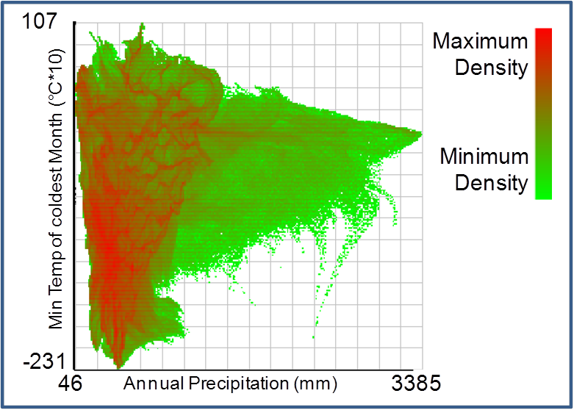
US Environmental Space

Slide 6
Tamarisk Occurrences

Slide 7
Alternatives to Polynomials
BioClim – max and max boxes
BioMapper – 25x25 grid of boxes
DOMAIN – Distance to existing point
NPMR
Hyper-Envelope Modeling – Bezier Curves
Multivariate adaptive regression splines

Slide 8
Bezier and Spline Curves
P₁
P₀
P₃
P₂
Wikiepedia.com

Slide 9
Modified Bezier Curves
$$B\left(t\right)=at^{3}+bt^{2}+S_{1}t+P_{1}$$
S₃
S₂
P₂
P₃
S₁
P₀
P₁
S₀

Slide 10
HEMI 2
Limited to one response curve per predictor
  Similar to MaxEnt and traditional regression
  Predictors can be transformed to adapt for this to some extent
Up to 10 predictors
New interactive interface with immediate feedback

Slide 11
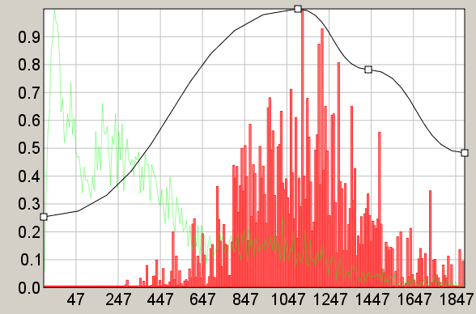
HEMI 2 Model
Remaining Points can be moved vertically and horizontally
Last point is “tied” to the left edge and the bottom
1st point is “tied” to the left edge and the bottom

Slide 12
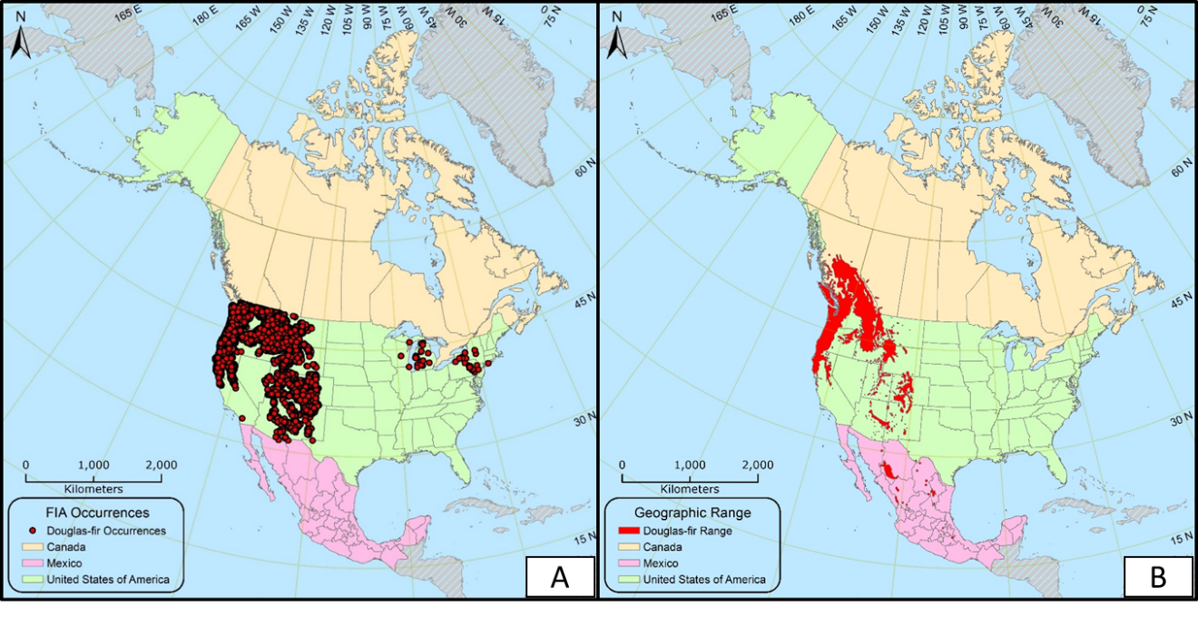
Douglas-Fir
This and the following taken from Mellissa Kimble’s 2016 thesis.

Slide 13
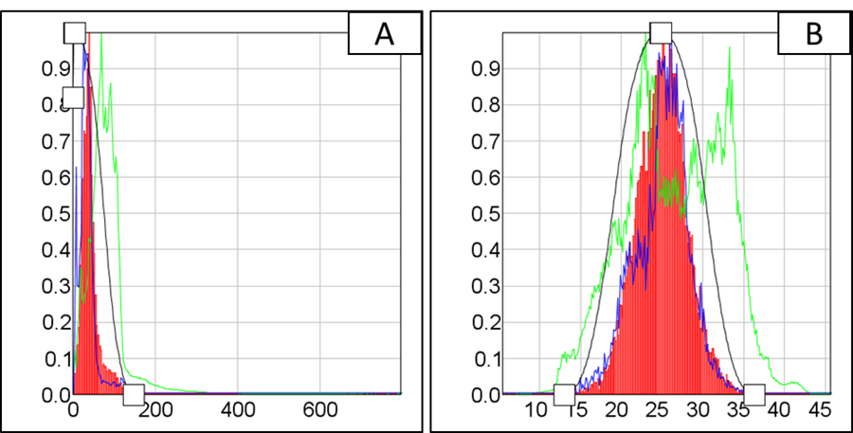
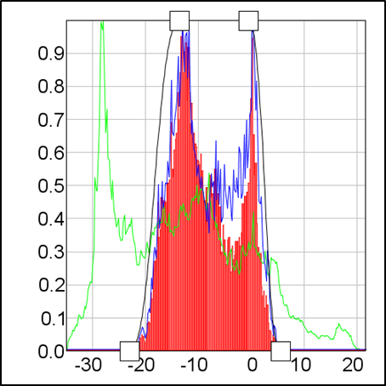
Doug-Fir Response
C
A – Average Precipitation for August (mm)
B – Average Max Temp for July (°C)
C – Average Minimum Temp for Jan (°C)

Slide 14
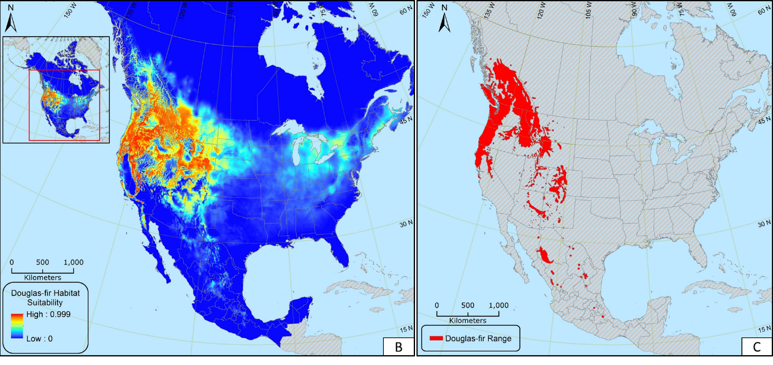
Doug-Fir: Model & Historic Range
Potential habitat suitability map of the study area (A), North America (B), and the historic range (C) for Douglas-fir. Both HSMs were downsampled to 4-km and have no noise included.

Slide 15
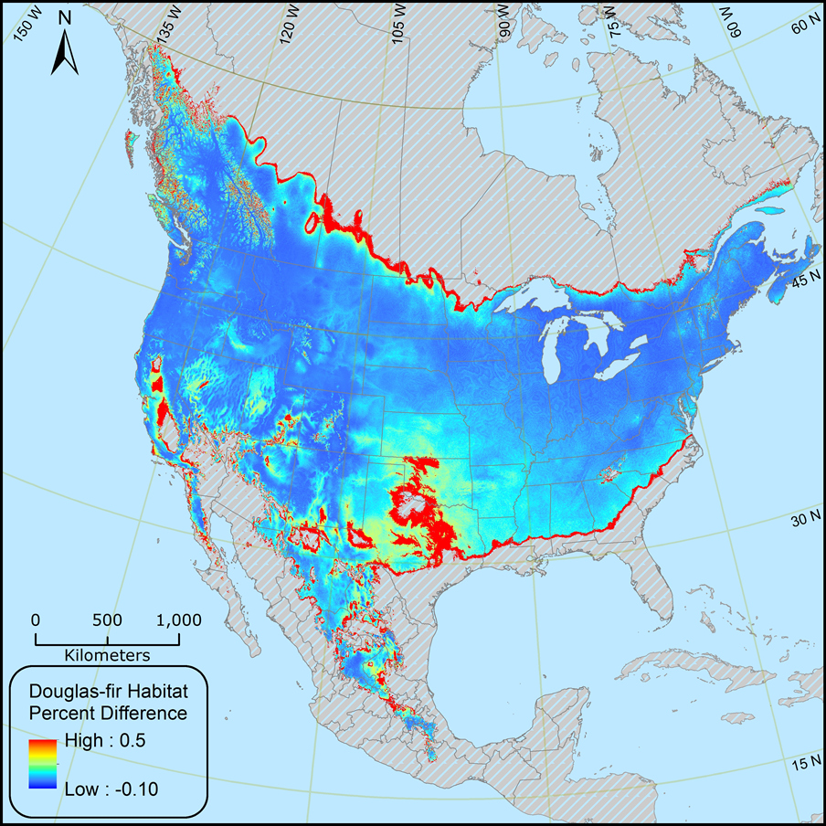
Noise
Injection
Notes:
Percent difference of predicted habitat suitability for HSMs with noise and with no noise included for Douglas-fir. High (0.5, or 50%) percent difference represents the average change in predicted habitat suitability between an HSM with noise and with no noise included for Douglas-fir. I.e., A negative pixel value would indicate that the value for habitat suitability decreased when noise was injected into the HSM.

Slide 16
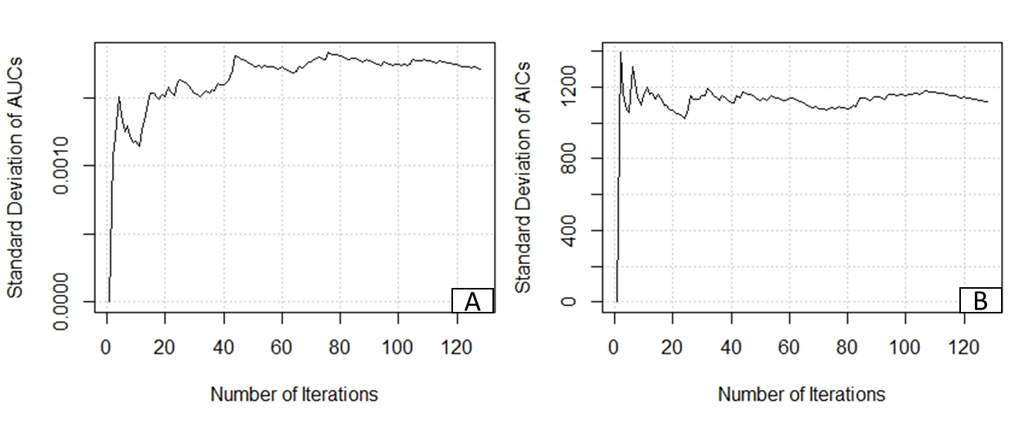
Stability Plots

Slide 17
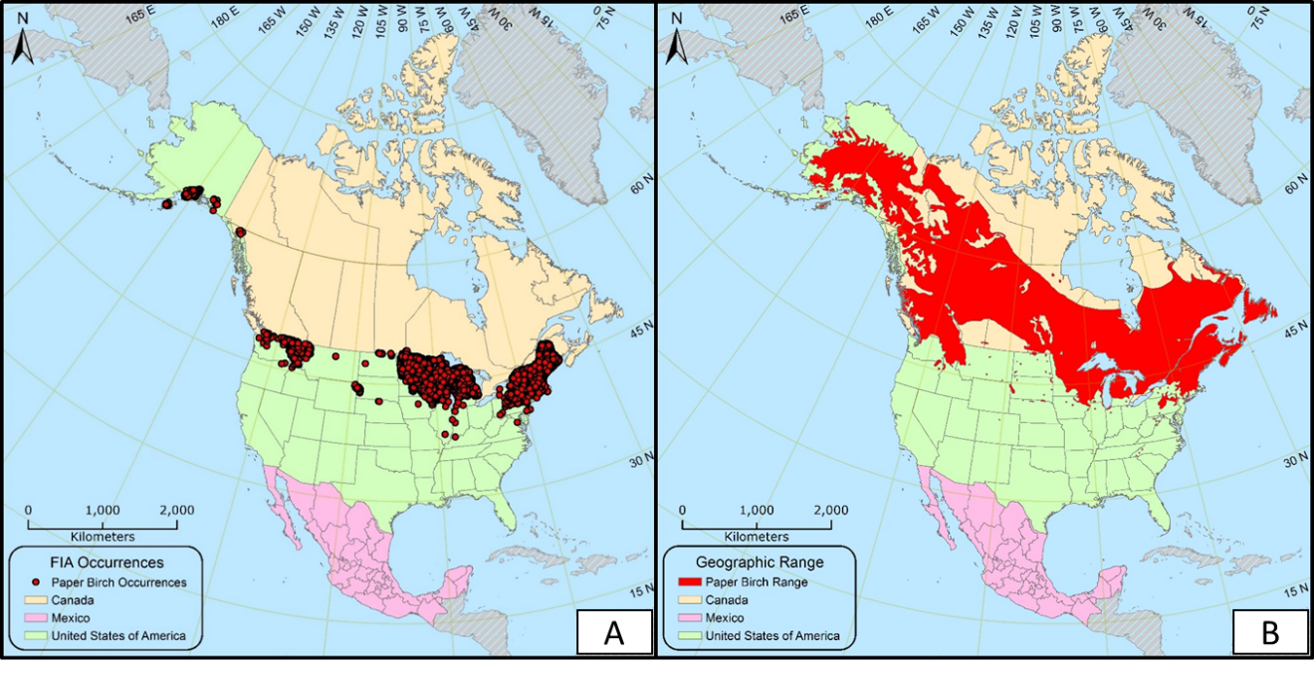
Paper Birch

Slide 18
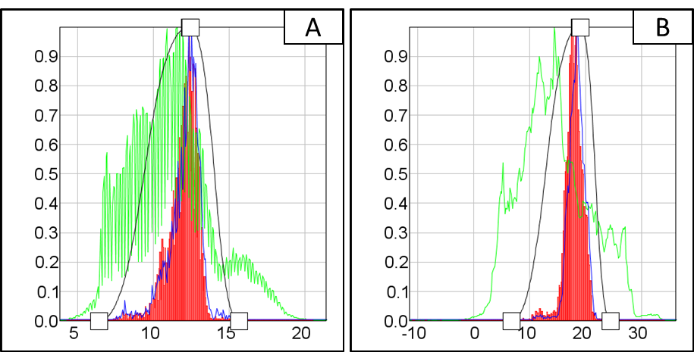
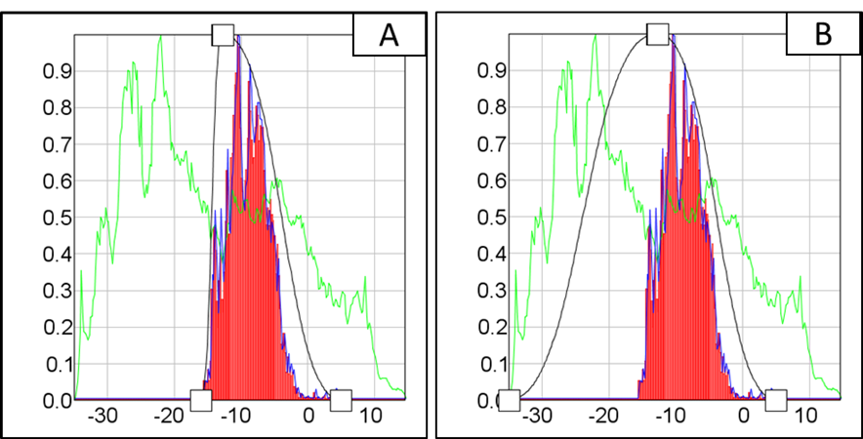
A – Mean Diurnal Range, B – Temperature of the Warmest Quarter
A - Temperature of the Coldest Quarter, B – Manually Modified

Slide 19
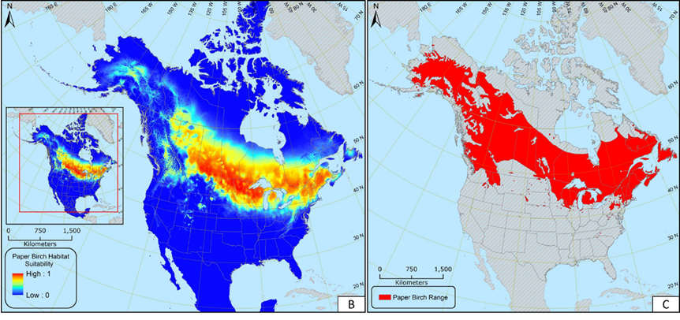
Paper Birch - Modified

